Slide 1
Application Controller Pattern
Zane Pace

Slide 2
What is it?
The application controller is responsible for taking care of business logic and does not intrude into the responsibilities of the domain model. For every user interaction, the web application is in a specific state. Every state has previously defined events which once happened, these predefined events may alter from one state of the application, for a certain user, to the other state. Every alteration is linked with a certain response, which is presented to the user at the end. In order to analyze the request further, application controllers stand behind the action controller. It may also stand behind a front controller in order to substitute the classical page controllers that it is being forwarded to. The domain classes are the one on which then events are supposed to provoke the execution of the methods. The application controllers contain references to the domain class and the view class, as a collaborator and because these classes are supposed to render responses.

Slide 3
What does this mean in English?
It's just what it says: a centralized point to control the navigation between screens.

Slide 4
Why do we need it?
The Application Controller is a sub pattern required in the Web implementations. This controller is placed in between the controllers that are related to HTTP, such as front controllers and action controllers and the remaining MVC machine part of the application. It can also be used in order to substitute them. In an MVC implementation, this pattern includes a layer of complexity in addition. It is more helpful when modeling the interactions as a state machine.
The application controller can be put to advantage when it is being used in a full-featured web application. It works better than the old page based controllers. The dynamic pages are not supposed to available all the time, as they are produced on a fly. These pages depend on the pages prior to it. They might even be accessible only until after the events have already happened.

Slide 5
Structure
The structure of the application controller is such that it connects the intercepting filter, front controller, mapper, map, and target. All of these objects are centralized by the application controller. The client gets responses from the intercepting filter and the front controller. It then delegates it further to the application controller. The application controller sends the request to the mapper which further sends it to the map object. The application controller invokes the target while the mapper provides the target. The application controller pattern is used to cater many different issues and it gives the benefit of improved reusability, modularity, and extensibility.

Slide 6
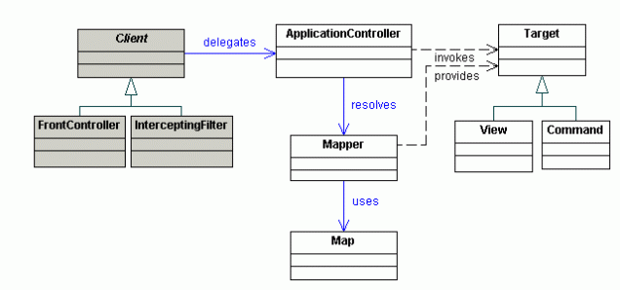
Structure Cont.

Slide 7
Why use it?
The application controller pattern is used to cater many different issues and it gives the benefit of improved reusability, modularity, and extensibility. Use an Application Controller to centralize retrieval and invocation of request-processing components, such as commands and views.

Slide 8

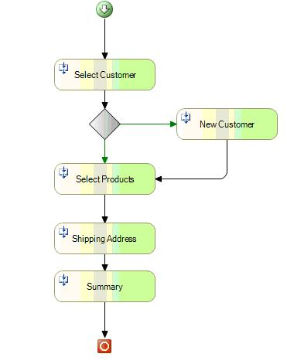
Example
Select Customer maps to SelectCustomer Object
New Customer maps to NewCustomer Object
Select Products maps to SelectProducts Object
ShippingAddress maps to Shipping Address Object
Summary maps to Summary Object

